Slide 1
Natural Language Processing
Programming Lab 2 - GROUP 2
Muskan Manav, Astha Anand, Parinishtha Bhalla, Deepika Pradeep
15th Feb 2023, b-it center, Bonn

Slide 2
Introduction
Introduction
Retrieving data
NER model
Database integration
GUI & walkthrough
Discussion

Slide 3
Project objective
Develop a search engine using Named Entity Recognition (NER) technology which can find relevant papers from a corpus of PubMed abstracts
Corpus - biomedical review papers on cancer from the MEDLINE database, published between Jan 2020 and Dec 2022

Slide 4
Overview of software architecture
MEDLINE database
NER model
User interface
NCBI E-Utilities API
Entity prediction
Database
Containerization
Cached abstracts
(user system)

Slide 5
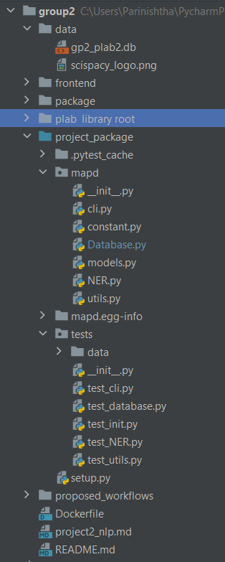
Package Structure
Frontend
Project package
README.md
Dockerfile
Unit tests
Cli.py
Other

Slide 6
Retrieving data
Introduction
Retrieving data
NER model
Database integration
GUI & walkthrough
Discussion

Slide 7
NCBI E-utilities API
Public API to the NCBI Entrez system and allow access to all Entrez databases including PubMed, PMC.
Series of more than 100 requests, do at weekends/outside USA peak times
Entrez Guidelines
Use the http://eutils.ncbi.nlm.nih.gov/ address
No more than 3 requests every second

Slide 8

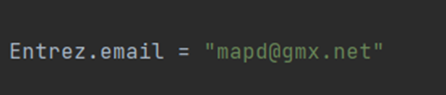
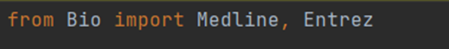
Use of Biopython
Important & recommended!
Optional email parameter for NCBI to contact you in case of a problem.
Importing the Entrez

Slide 9
Code Overview : API
class Utilapi
ESearch method
EFetch method
Returns a list of UIDs that match a text query in a given Entrez database
E.g. pubmed UID → PMID
Generates formatted output for a list of input UIDs.
E.g. abstracts from Entrez PubMed

Slide 10
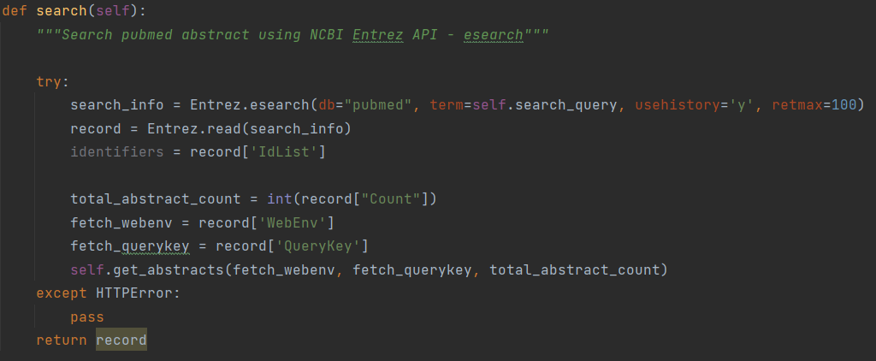
ESearch: Searching a database
Search query string included terms combined with Boolean operators, filters such as type of article and organism, date of publication range, language.

Slide 11
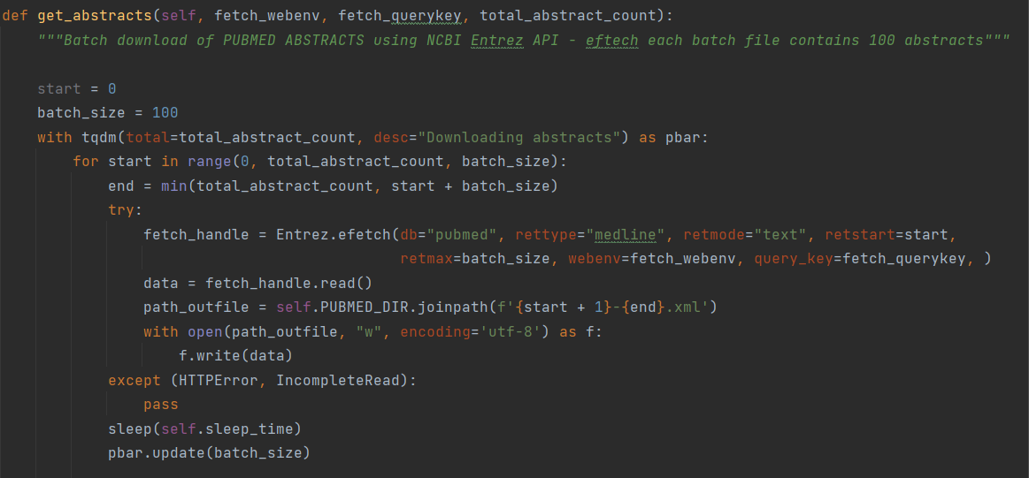
EFetch: Downloading Records
Caching data files

Slide 12
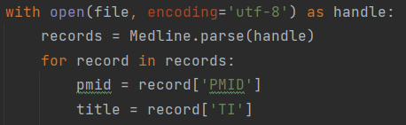
Use of Bio.Medline package
Read Medline records one by one from the handle.
Issues faced while parsing dates and abstracts, to be stored in the database
class Database
add_abstract_to_db()
parsed data stored
Abstract Table

Slide 13
NER model
Introduction
Retrieving data
NER model
Database integration
GUI & walkthrough
Discussion

Slide 14
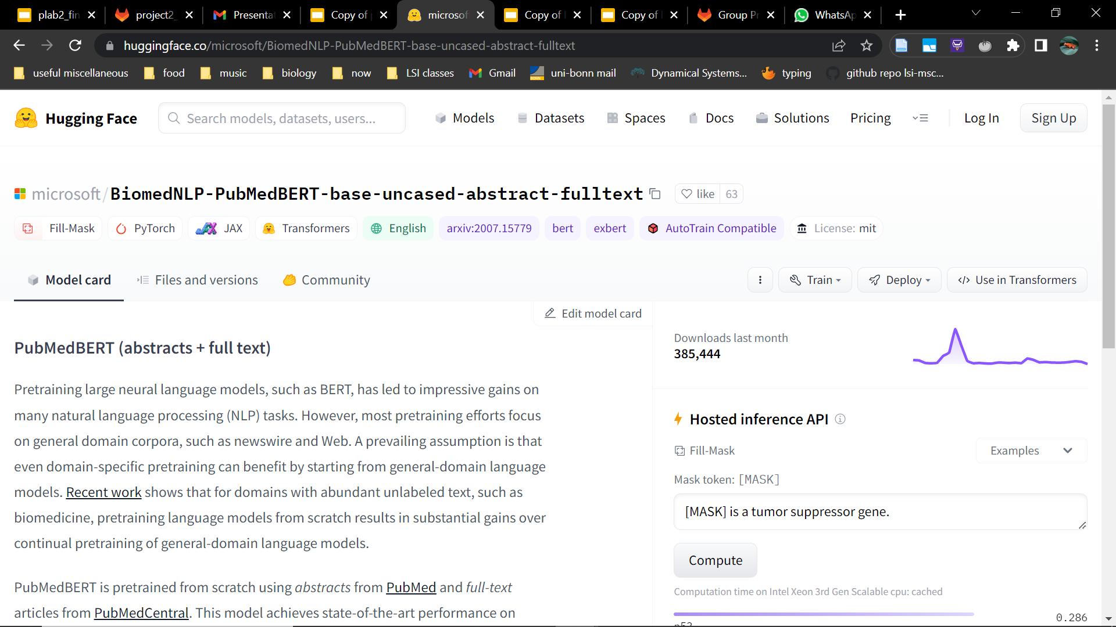
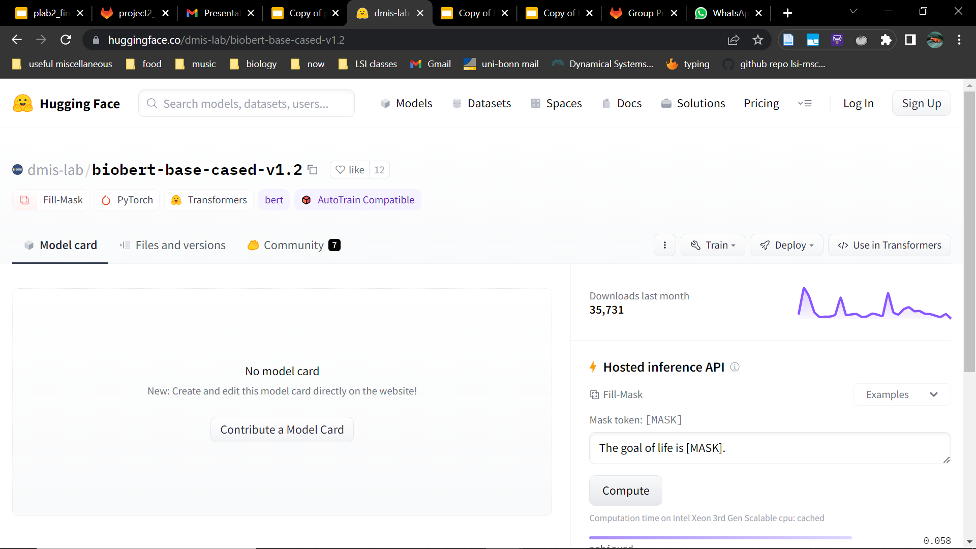
Attempted NER models
Pretrained BERT (Bidirectional Encoder Representations from Transformers) models from Hugging Face transformers library
Built models, NER pipelines for tagging abstracts
Both models gave very poor results, with and without further training
e.g. words like “a” and “the” were tagged as “gene” or “cell line” entities

Slide 15

scispaCy
Python package
Contains SpaCy NLP models trained on biomedical, scientific or clinical corpora
Model we used - en_ner_bionlp13cg_md
NER model trained on the BIONLP13CG corpus
17 categories of entities (‘labels’)
label | CELL | SIMPLE_CHEMICAL | ORGANISM | GENE_OR_GENE_ PRODUCT
entity | ‘Haematopoietic progenitor’ | ‘Rapamycin’ | ‘Zebrafish’ | ‘TSC1’

Slide 16
Database integration
Introduction
Retrieving data
NER model
Database integration
GUI & walkthrough
Discussion

Slide 17
Database creation
MySQL used to store and handle data
Sqlalchemy - used to communicate with database
Abstract table
Entity table
Table id | Integer
Title | String
Pubmed ID | Integer
Date | DATE
Abstract text | TEXT
Table id | Integer
Entity | String
Labels | String
Abstract id | Integer
Abstracts
retrieved
using API
NER model used to tag abstracts with entities

Slide 18
Database class
build()
Builds a new database with empty Abstract and Entity tables
If a database does not exist or if empty, build() is called upon instantiation of the Database class
Class Database
rebuild()
Deletes tables in database and rebuilds an empty database with new tables
Drops all tables associated with database
drop()

Slide 19

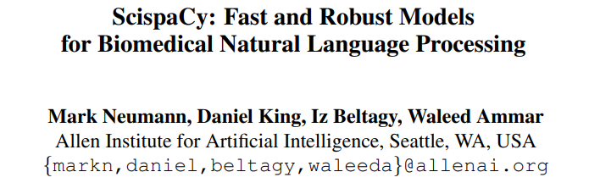
SciSpacy Model
POS tagging
Dependency parsing
NER
Relevant Datasets, tokenization module with additional rules.
scispacy | SpaCy models for biomedical text processing (allenai.github.io)
1902.07669v1.pdf (arxiv.org)

Slide 20
Models Available
model | F1 | Entity Types
en_ner_craft_md | 76.75 | GGP, SO, TAXON, CHEBI, GO, CL
en_ner_jnlpba_md | 72.28 | DNA, CELL_TYPE, CELL_LINE, RNA, PROTEIN
en_ner_bc5cdr_md | 84.53 | DISEASE, CHEMICAL
en_ner_bionlp13cg_md | 76.57 | AMINO_ACID, ANATOMICAL_SYSTEM, CANCER, CELL, CELLULAR_COMPONENT, DEVELOPING_ANATOMICAL_STRUCTURE, GENE_OR_GENE_PRODUCT, IMMATERIAL_ANATOMICAL_ENTITY, MULTI-TISSUE_STRUCTURE, ORGAN, ORGANISM, ORGANISM_SUBDIVISION, ORGANISM_SUBSTANCE, PATHOLOGICAL_FORMATION, SIMPLE_CHEMICAL, TISSUE

Slide 21
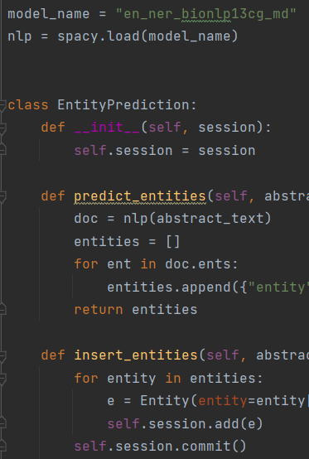
NER Model
predict_entities()
abstract_text
Load pipeline
List of dictionary key:Entity,value:Label
Select Model
Load Model
Class EntityPrediction
attribute:session
"en_ner_bionlp13cg_md"
insert_entities()
abstract_id,entities
Insert entity in the Database

Slide 22
Database Creation
add_abstract_to_database()
Check PUBMED cache directory
Else Calls Utilapi(QUERY_STRING).search()
If date & Abstract “” skips
Add unique Pubmed Id in Abstract Table
ABSTRACT TABLE
Class Database
add_entity_data()
add_abstract_to_database()
Filter by Abstract_id
If Entities exists - Continue
Else call class EntityPrediction(session)
predict_entities(abstract.abstract_text)
insert_entities(abstract.id, entities)
ENTITY TABLE
get_entity_dict()
Dictionary of Entity & Labels from Entity Table

Slide 23
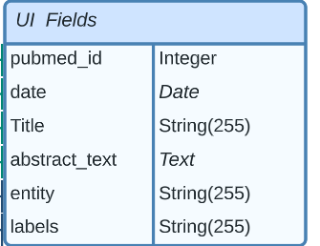
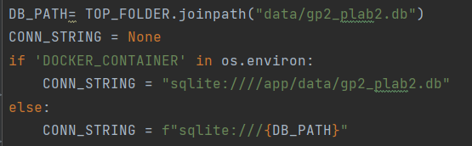
GUI Connection
get_abstract_info( )
Use pubmed_id
Select statement: Filter by pubmed_id
Dictionary: pubmed_id,Title,date,abstract_text,entities,labels
Utils.py
GUI
For loop
query_database()
Use similar keyword
optional:start_date,end _date
Select pubmed ids from Abstract Table with %keyword%
get_abstract_info(pubmed_id )

Slide 24
Issues
API issue
Package issue
Date Issue
Solution: Trying different date formats and Try & Except statements
Empty Abstract in some .xml files
Solution: Ignored while creating Database
Avoiding Duplicates
Solution: Inserting only Unique PubmedId
Containerization:
Database Connection
Using Env Variable while building Container

Slide 25
Command line interface
Command | Function
Build, rebuild the database | build-db; rebuild-db
get a dictionary of the entities and their labels | get-entity-dict
retrieve information about an abstract | get-abstract-info
predict entities for a given text | predict-entities
query the database | query-db
start the web server | serve
Can be used to build database after downloading the package
Detailed help section
Issues with serve command

Slide 26
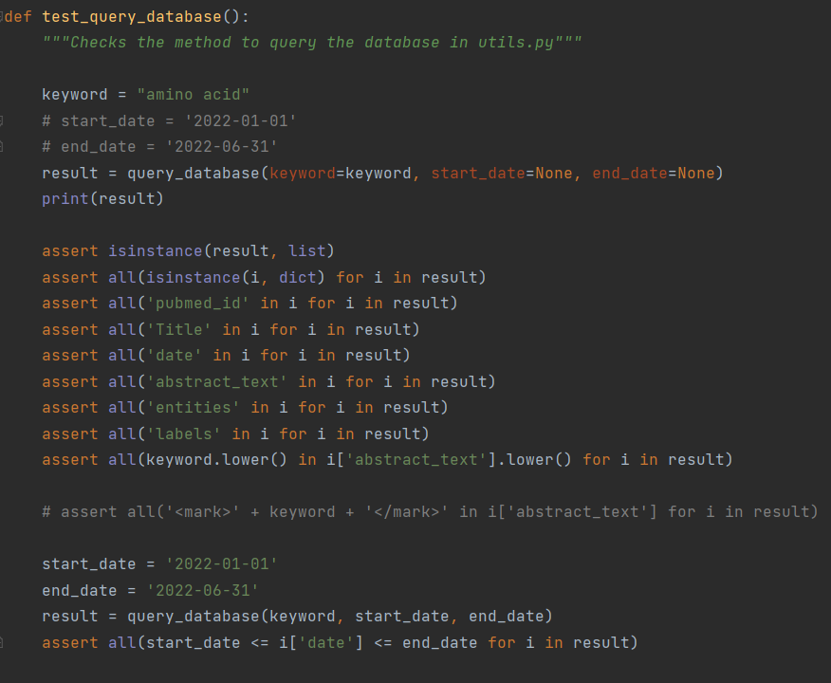
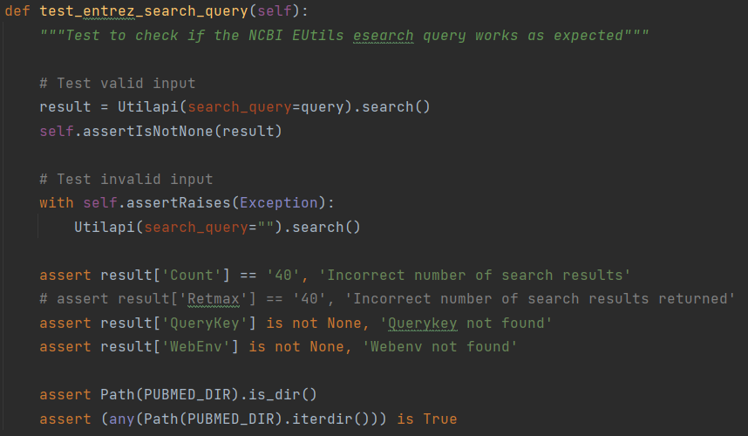
Unit tests
All passed
Example 2: To test utils.py
Example 1: To test API

Slide 27
GUI & walkthrough
Introduction
Retrieving data
NER model
Database integration
GUI & walkthrough
Discussion

Slide 28
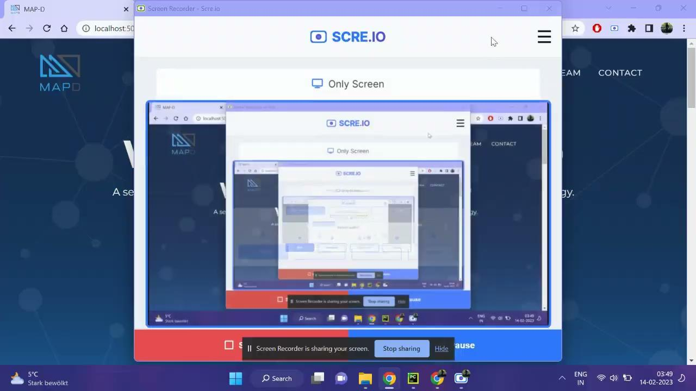
Front-end development
MAP-D walkthrough

Slide 29
Approach
Dummy database and pseudo query function.
Integrated with real data and query_database().

Slide 30
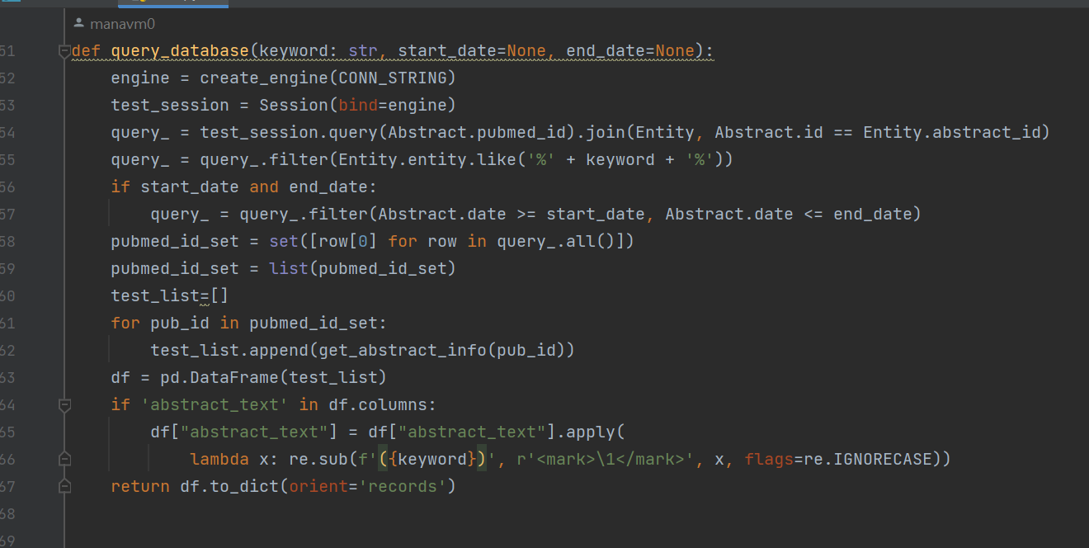

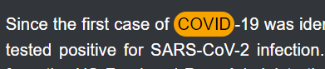
Code overview
query_database()

Slide 31
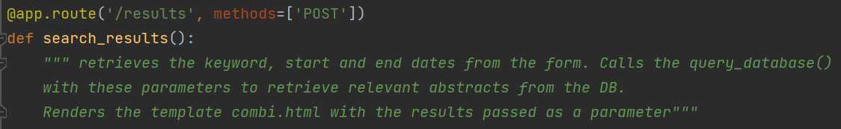
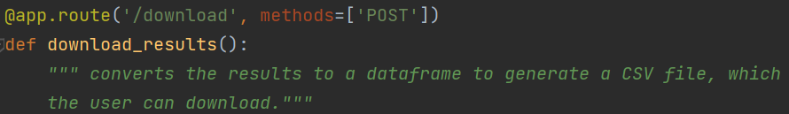
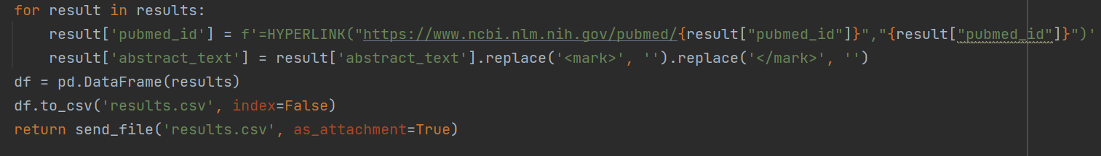
run.py

Slide 32
Website design
Jinja
HTML
Bootstrap
CSS
JavaScript

Slide 33



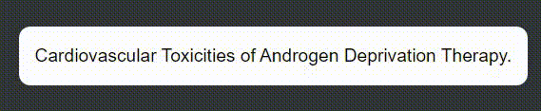
CSS Custom Animated Elements

Slide 34
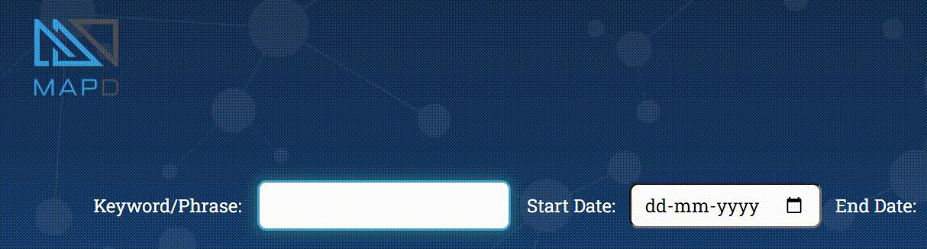
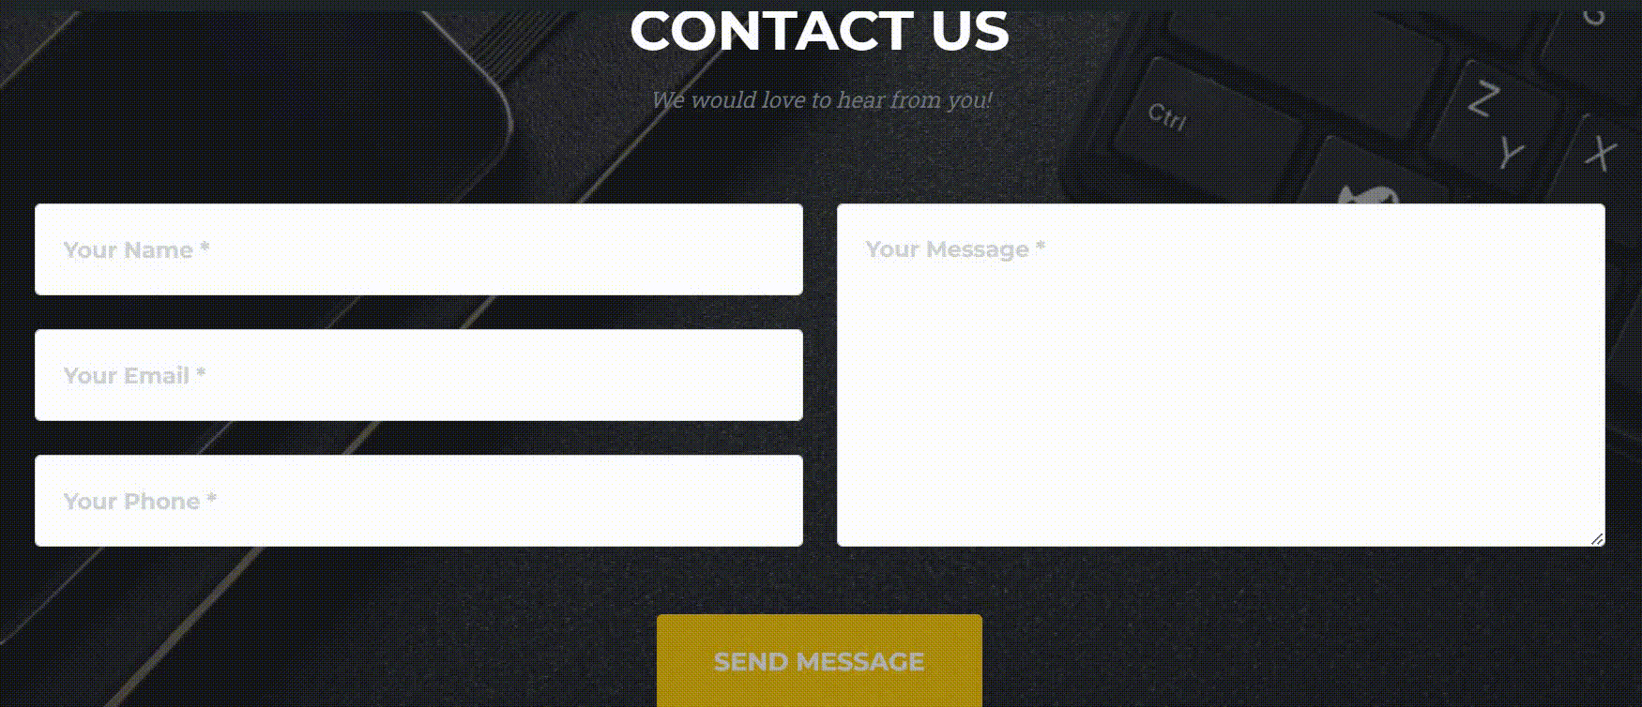
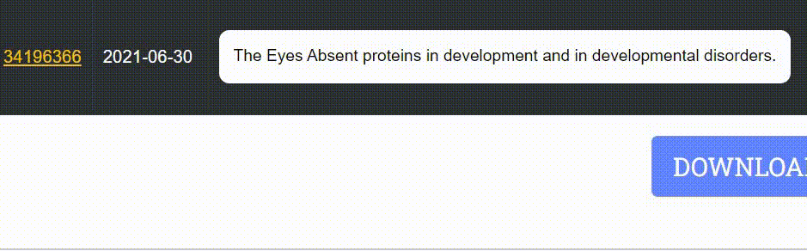
JavaScript Custom Elements

Slide 35
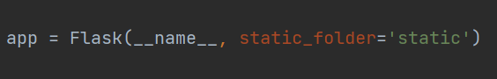
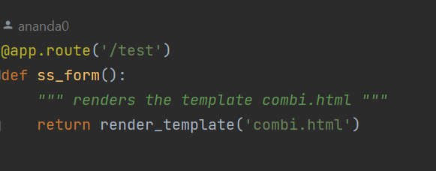
Issues faced during front-end development
Infinite loading issue if user entered space instead of a keyword. Fixed by adding JS validation.
Establishing connection of image folder, CSS, JS files with run.py for containerization. Solution:
Unable to preview updated CSS changes. Fixed by deleting cached data after each CSS update.
Having to enter keyword on index page to open results page in order to view edits made for the results page. Solution:

Slide 36
Discussion
Introduction
Retrieving data
NER model
Database integration
GUI & walkthrough
Discussion

Slide 37
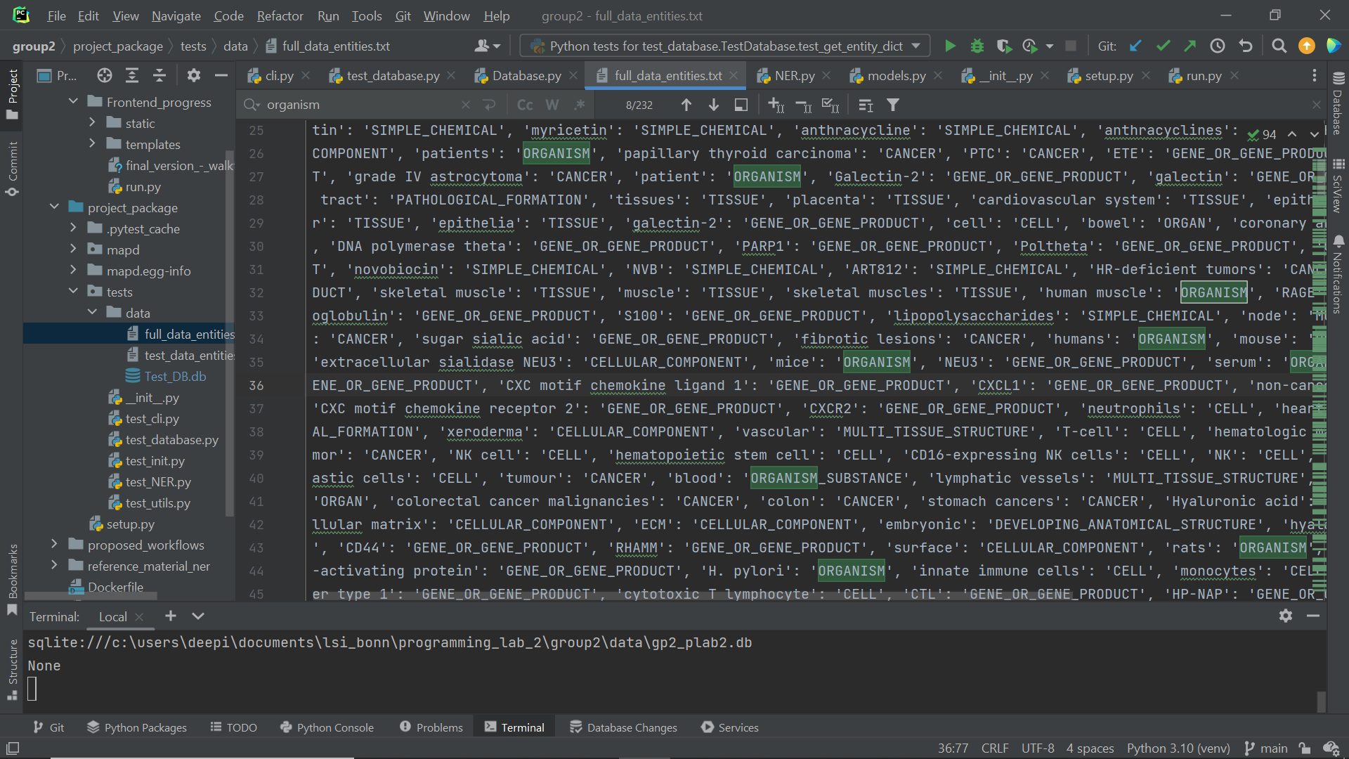
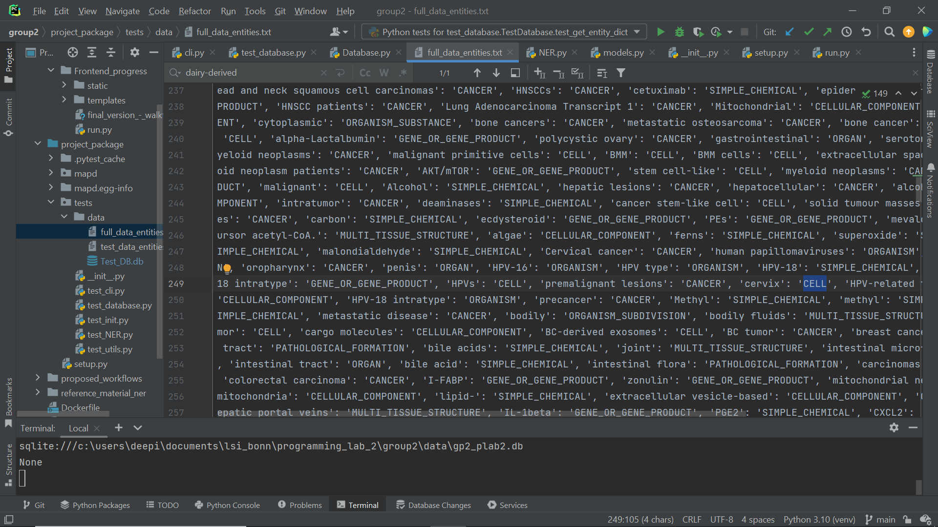
Discussion and possible improvements
NER model - some errors in entity prediction
Could improve search time for database query
Map terms to broader categories - more meaningful hypothesis generation
Combine search terms for more refined queries (Boolean operators)
Errors seen in tagged entities

Slide 38


